Slide 1
Angle Analysis for SVA
Meilei Jiang
Department of Statistics and Operations Research
UNC-Chapel Hill

Slide 2
Review of Surrogate Variable Analysis
The overall goal of SVA is to provide a more accurate and reproducible parsing of signal and noise in the analysis of an expression study when Expression Heterogeneity (EH) is present.

Slide 3
Review of Surrogate Variable Analysis
Step 1: Detect the surrogate variable
Remove the signal due to the primary variable of interest to obtain a residual expression matrix.
Apply a decomposition to the residual expression matrix to identify signatures of EH.
Use a statistical test to determine the singular vectors that represent significantly more variation than would be expected by chance.

Slide 4
Review of Surrogate Variable Analysis
Step 2: Identify the subset of genes driving each orthogonal signature of EH.
Apply a significance analysis of associations between genes and the EH signatures on the residual matrix.

Slide 5
Review of Surrogate Variable Analysis
Step 3: For each subset of genes, build a surrogate variable based on the full EH signature of that subset in the original expression data.

Slide 6
Review of Surrogate Variable Analysis
Step 4: Include all significant surrogate variables as covariates in subsequent regression analysis.

Slide 7
Design of Simulation
High dimension low sample size setting:
80 samples in columns, 100 genes in rows
80 samples are associated with two classes:
40 samples are in Class 1
40 samples are in Class 2
Class Vector: y = (1_{n11}, 1_{n12}, 0_{n21}, 0_{n22})
80 samples are collected from two batches: Batch 1 and Batch 2
π₁ of samples in Class 1 are collected from Batch 1
π₂ of samples in Class 2 are collected from Batch 1
Batch Vector: bv = (1_{n11}, 0_{n12}, 1_{n21}, 0_{n22})
Note: n11 = π₁*40, n12 = 40 – n11; n21 = π₂*40, n22 = 40 – n21

Slide 8
Design of Simulation
Balance Design: π₁= π₂ = 0.5
Unbalance Design
Case I: π₁ = π₂, π₁ + π₂≠1
Batch vector and primary variable vector are uncorrelated.
Sizes of two batches are different.
Case II: π₁≠ π₂, π₁ + π₂ = 1
Batch vector and primary variable vector are correlated.
Sizes of two batches are the same.
Case III: π₁≠ π₂, π₁ + π₂ ≠1
Batch vector and primary variable vector are correlated.
Sizes of two batches are different.

Slide 9
Design of Simulation
Settings of genes for effects of primary variable and batch.
Type 1: Gene 1 – s1:
Primary variable effect + random noise
Type 2: Gene s1 + 1 – s2:
Primary variable effect + batch effect + random noise
Type 3: Gene s2 + 1 – s3:
batch effect + random noise
Type 4: Gene s3 + 1– s4:
random noise
The size of four types (t1, t2,t3, t4) = (20, 20, 20, 40)
40% genes are affected by primary variable.
40% genes are affected by batch.
20% genes are affected by both.

Slide 10
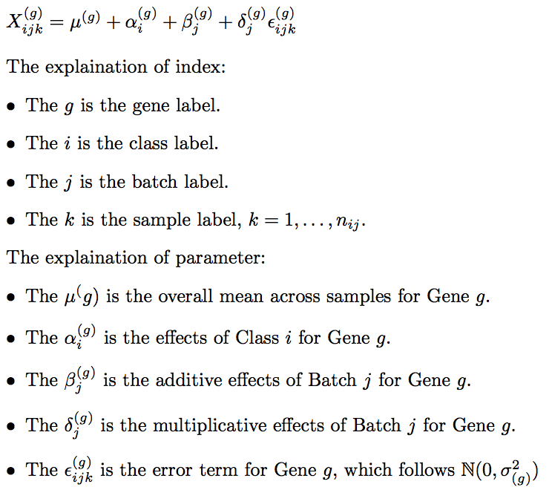
Location and Scale Batch Effect Model

Slide 11
Design of Simulation
Primary Variable Effect
Class 1: α₁ = 2
Class 2: α₂ = -2
Batch Effect:
Additive Effect
Batch 1: β₁ = 2
Batch 2: β₂ = -2
Multiplicative Effect
Batch 1: δ₁ = 1
Batch 2: δ₂ = 2
Random Noise
N(0 , 1)

Slide 12
Summary of Simulation: Additive Batch Effect
SVA works well in the balanced case.
The Unbalanced Design Case I will shift the estimation of class effects.
The Unbalanced Design Case II will amplify or shrink the difference between the two class effects.
SVA can identify the surrogate variable in the Unbalanced Design Case I but can not adjust the shift.
SVA may fail in the extreme cases of the Unbalanced Design Case II. SVA can adjust the bias caused by the Unbalanced Design Case II.

Slide 13
Summary of Simulation: Multiplicative Batch Effect
Multiplicative Batch Effect is heteroscedasticity.
The SVA will fail under this heterogeneity setting.

Slide 14
Angle Analysis

Slide 15
Angle Analysis

Slide 16
Angle Analysis

Slide 17
Summary of Angle Analysis
When the class vector and the batch vector are correlated, the surrogate variable will fail to find the batch vector.
There exists a ‘magic’ contour.
The surrogate variable and the class vector are uncorrelated or weakly correlated.
This is not surprised since surrogate variable is constructed from the residual matrix.

